Slide 1

Smart Online Examination System

Slide 2
Aim
To design and develop a Smart Online Examination System that conducts online tests, evaluates student answers automatically, calculates marks, and displays examination results.
Software requirements :
Component | Technology
Frontend | HTML, CSS, JavaScript
Backend | Node.js
Framework | Express.js
Database (extended version) | MongoDB
Code editor | VS Code
Browser | Chrome

Slide 3
Procedure :
Step 1: Install the required software
Install Node.js.
Install Visual Studio Code.
Open VS Code.
Step 2: Create a project folder
Create a folder named OnlineExamSystem.
Open the VS Code terminal and execute:
</Bash>
mkdir OnlineExamSystem
cd OnlineExamSystem
npm init –y
npm install express

Slide 4
Step 3: Create the following folder structure
</> Plain Text
OnlineExamSystem/
│
├── server.js
│
└── public/
├── index.html
├── style.css
└── script.js
Step 4: Develop the frontend
Create the HTML page for student login, questions, options, and results.
Step 5: Develop the backend
Use Express.js to create routes for retrieving questions and submitting answers.
Step 6: Run the application

Slide 5
</> Bash node server.js
Open your browser and visit:
</> Plain text
http://localhost:3000
Program code :
Create the following four files inside your project folder.
File 1: server.js (Backend)
This program creates the Express server, provides examination questions, evaluates answers, and calculates the final score.

Slide 6
const express = require("express");
const app = express();
app.use(express.json());
app.use(express.static("public"));
const questions = [ { id: 1,
question: "Which language is used for web page structure?",
options: ["Python", "HTML", "Java", "C"],
answer: "HTML"
},
{
id: 2,
question: "Which of the following is a JavaScript framework?",
options: ["React", "MySQL", "HTML", "CSS"],
answer: "React"
},
{
id: 3,
question: "Which database is a NoSQL database?",
options: ["Oracle", "MySQL", "MongoDB", "SQLite"],
answer: "MongoDB"
},
{
id: 4,
question: "Which technology is used for backend development?",
options: ["CSS", "Node.js", "HTML", "Bootstrap"],
answer: "Node.js"
},
{
id: 5,
question: "What does CSS stand for?",
options: [
"Computer Style Sheets",
"Creative Style System",
"Cascading Style Sheets",
"Colorful Style Sheets" ],
answer: "Cascading Style Sheets"
}];
// Store student results during the server session
const results = [];
// Get examination questions
app.get("/api/questions", (req, res) => {
const publicQuestions = questions.map(q => ({

Slide 7
id: q.id,
question: q.question,
options: q.options
}));
res.json(publicQuestions);
});
// Submit and evaluate examination
app.post("/api/submit", (req, res) => {
const { student, answers } = req.body;
if (!student || typeof student !== "string" ||
!student.trim() || !answers ||
typeof answers !== "object" || Array.isArray(answers)) {
return res.status(400).json({
message: "Invalid student name or answers"
});
}
let score = 0;
questions.forEach(q => {
if (answers[q.id] === q.answer) {
score++;
}
});
const result = {
student: student.trim(),
score: score,
total: questions.length,
percentage: (score / questions.length) * 100,
status: score >= 3 ? "Pass" : "Fail"
};
results.push(result);
res.json(result);
});
// View all examination results
app.get("/api/results", (req, res) => {

Slide 8
res.json(results);
});
// Start server
app.listen(3000, () => {
console.log("Online Examination System Started");
console.log("Open http://localhost:3000");
});
File 2: index.html (Frontend)
This page contains the student login, examination questions, timer, submit button, and result section.
</> HTML
<!DOCTYPE html>
<html>
<head>
<title>Smart Online Examination System</title>
<link rel="stylesheet" href="style.css">
</head>
<body>
<div class="container">
<h1>Smart Online Examination System</h1>
<div id="login">
<h2>Student Login</h2>
<input type="text" id="studentName"
placeholder="Enter Student Name">
<button onclick="startExam()">Start Exam</button>
</div>

Slide 9
<div id="exam" class="hidden">
<h2>Online Examination</h2>
<h3 id="timer">Time Left: 05:00</h3>
<form id="examForm">
<div id="questions"></div>
<button type="submit">Submit Exam</button>
</form>
</div>
<div id="result" class="hidden">
<h2>Examination Result</h2>
<div id="resultDetails"></div>
<button onclick="location.reload()">Try Again</button>
</div>
</div>
<script src="script.js"></script>
</body>
</html>
File 3: style.css (Design)
This file provides styling to the examination applicatio
</> CSS
body {
font-family: Arial, sans-serif;
background: #eef2f7;
margin: 0;
padding: 30px;
}

Slide 10
.container {
max-width: 750px;
margin: auto;
background: white;
padding: 25px;
border-radius: 12px;
box-shadow: 0 4px 15px #cccccc;
}
h1 {
text-align: center;
color: #174ea6;
}
h2 {
color: #333;
}
input {
width: 90%;
padding: 12px;
margin: 10px 0;
border: 1px solid #aaa;
border-radius: 5px;
}
button {
background: #174ea6;
color: white;
padding: 12px 20px;
border: none;
border-radius: 5px;
cursor: pointer;
margin: 10px 0;
}
button:hover {
background: #0d3578;
}
.question {
background: #f5f7fa;

Slide 11
padding: 15px;
margin: 15px 0;
border-radius: 8px;
}
.option {
display: block;
margin: 10px;
}
#timer {
color: red;
text-align: right;
}
.hidden {
display: none;
}
#resultDetails {
background: #e8f5e9;
padding: 20px;
border-radius: 8px;
line-height: 2;
}
File 4: script.js (Frontend functionality)
This JavaScript program fetches questions, handles student answers, manages the timer, and displays results.

Slide 12
</> JAVASCRIPT
async function startExam() {
student = document.getElementById("studentName").value.trim();
if (student === "") {
alert("Please enter your name");
return;
}
const response = await fetch("/api/questions");
const questions = await response.json();
let html = "";
questions.forEach((q, index) => {
html += `
<div class="question">
<h3>${index + 1}. ${q.question}</h3>
${q.options.map(option => `
<label class="option">
<input type="radio"
name="q${q.id}"
value="${option}">
${option}
</label>
`).join("")}
</div>
`;
});
document.getElementById("questions").innerHTML = html;
document.getElementById("login").classList.add("hidden");
document.getElementById("exam").classList.remove("hidden");
timerInterval = setInterval(updateTimer, 1000);
}
function updateTimer() {
timeLeft--;

Slide 13
let minutes = Math.floor(timeLeft / 60);
let seconds = timeLeft % 60;
document.getElementById("timer").textContent =
`Time Left: ${String(minutes).padStart(2, "0")}:${String(seconds).padStart(2, "0")}`;
if (timeLeft <= 0) {
submitExam();
}
}
document.getElementById("examForm").addEventListener("submit",
function(event) {
event.preventDefault();
submitExam();
}
);
async function submitExam() {
if (submitted) return;
submitted = true;
clearInterval(timerInterval);
const answers = {};
document.querySelectorAll(
"#questions input[type=radio]:checked"
).forEach(input => {
const id = input.name.substring(1);
answers[id] = input.value;
});
try {
const response = await fetch("/api/submit", {
method: "POST",
headers: {
"Content-Type": "application/json"
},
body: JSON.stringify({
student: student,

Slide 14
answers: answers
})
});
if (!response.ok) {
throw new Error("Unable to submit examination");
}
const result = await response.json();
document.getElementById("exam").classList.add("hidden");
document.getElementById("result").classList.remove("hidden");
document.getElementById("resultDetails").innerHTML = `
<h3>Student Name: ${result.student}</h3>
<h3>Marks: ${result.score}/${result.total}</h3>
<h3>Percentage: ${result.percentage}%</h3>
<h3>Status: ${result.status}</h3>
`;
} catch (error) {
submitted = false;
alert(error.message);
}
}
Expected output
Output 1: Student Login Page
When you open http://localhost:3000, the following page appears.

Slide 15
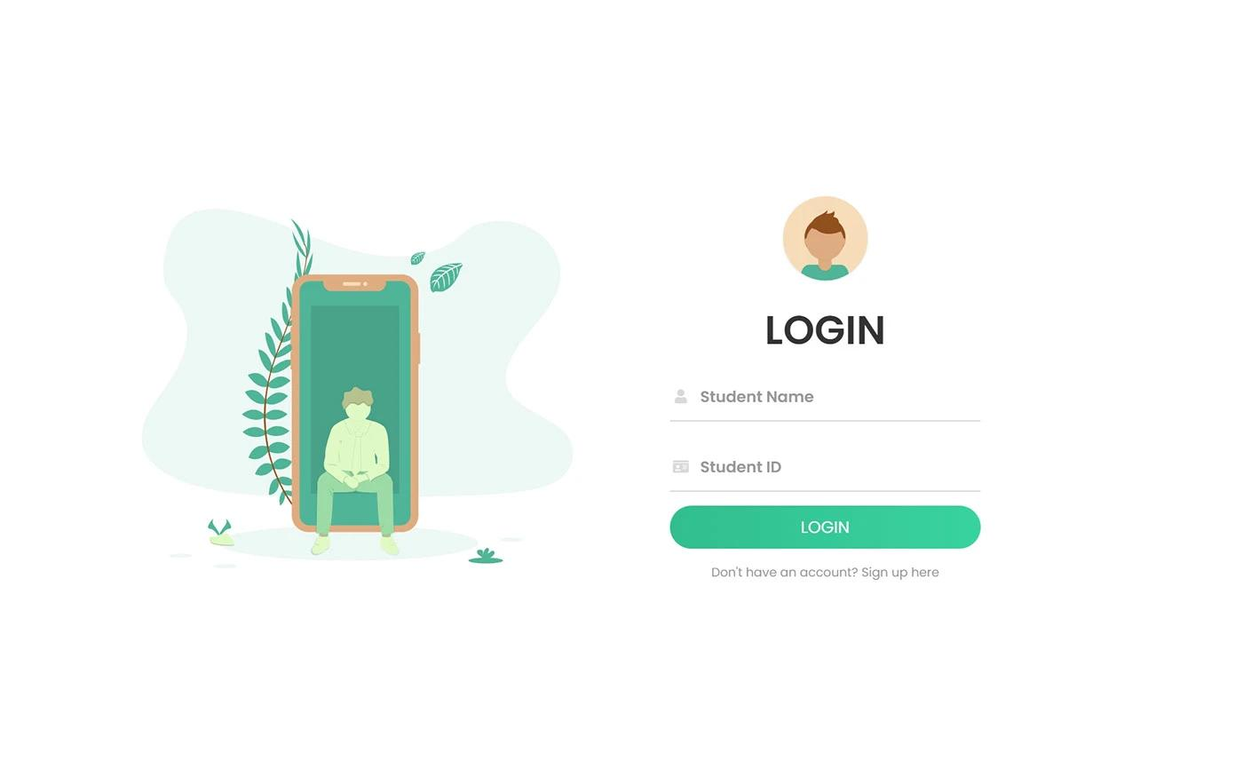

Slide 16
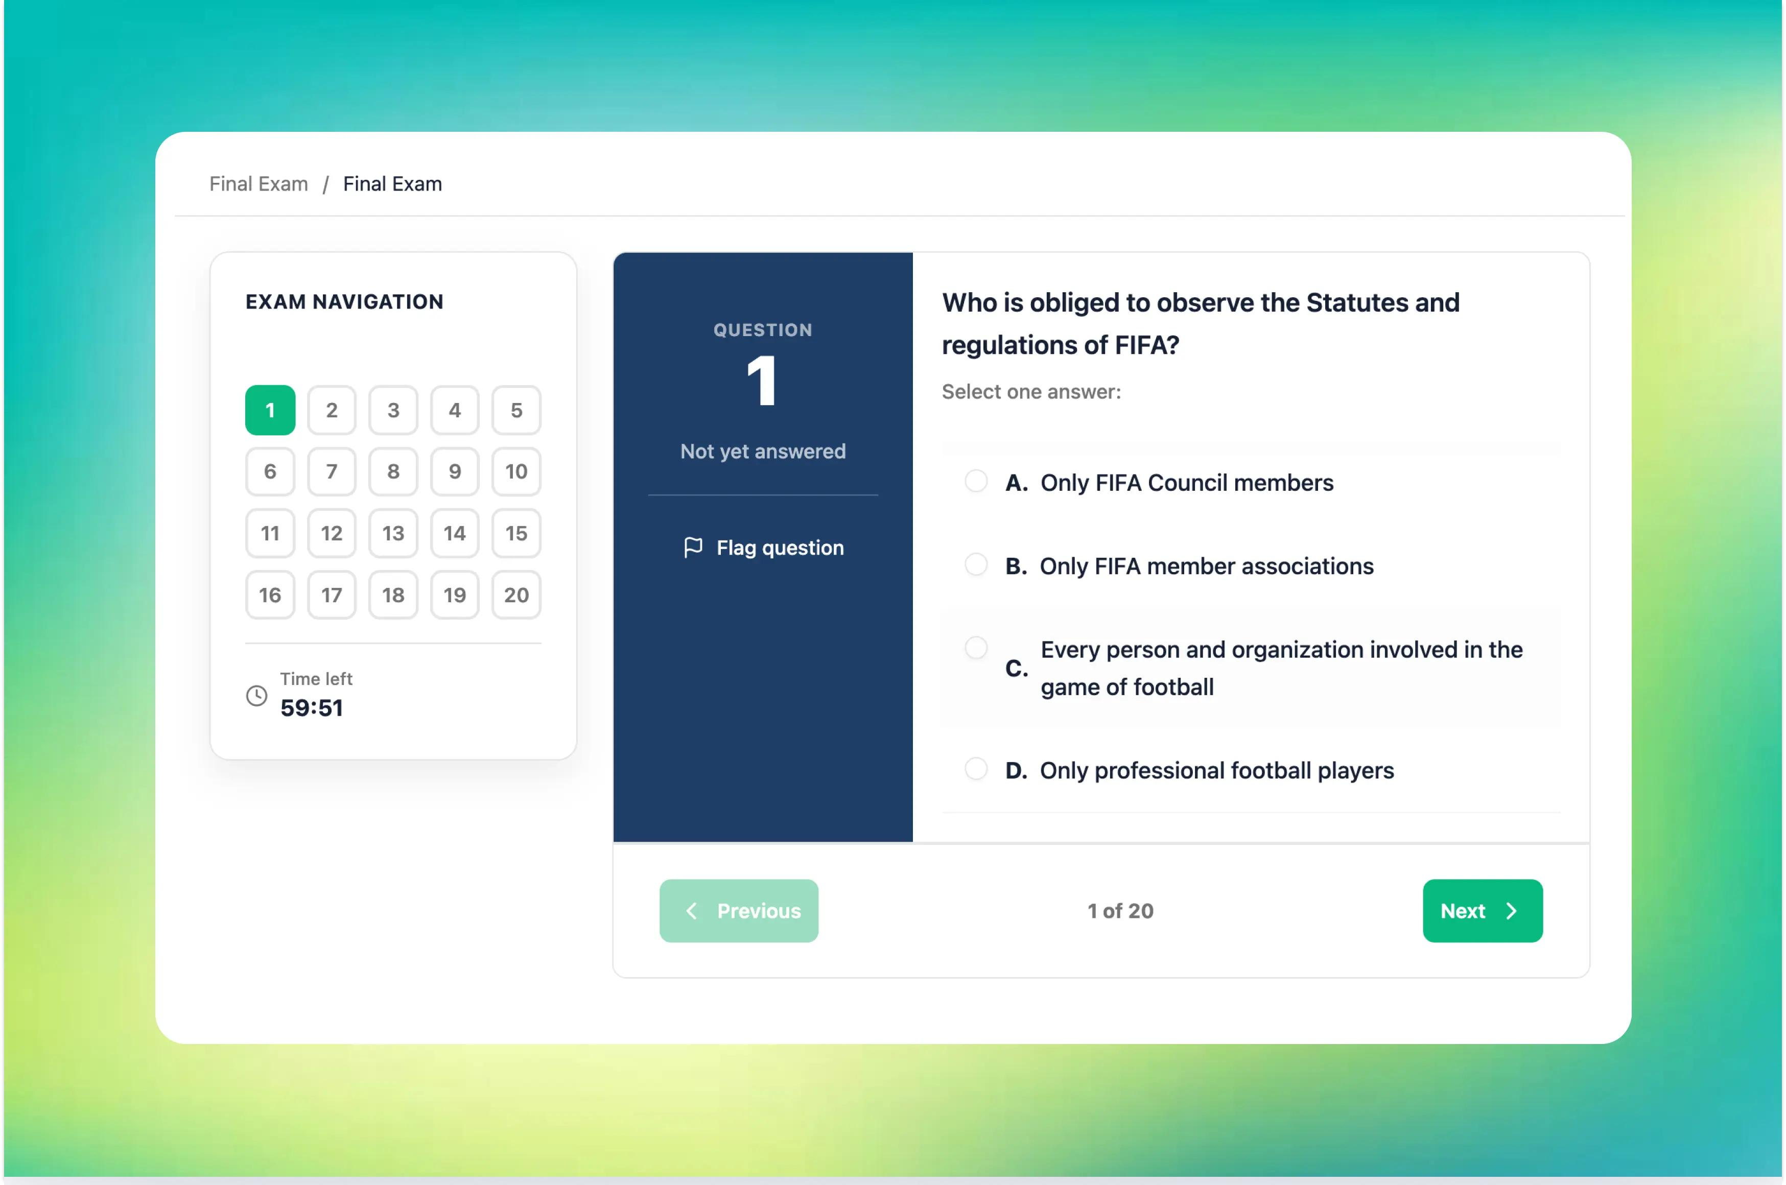
Output 2: Examination Page
After entering the student name and clicking Start Exam, the questions are displayed.

Slide 17
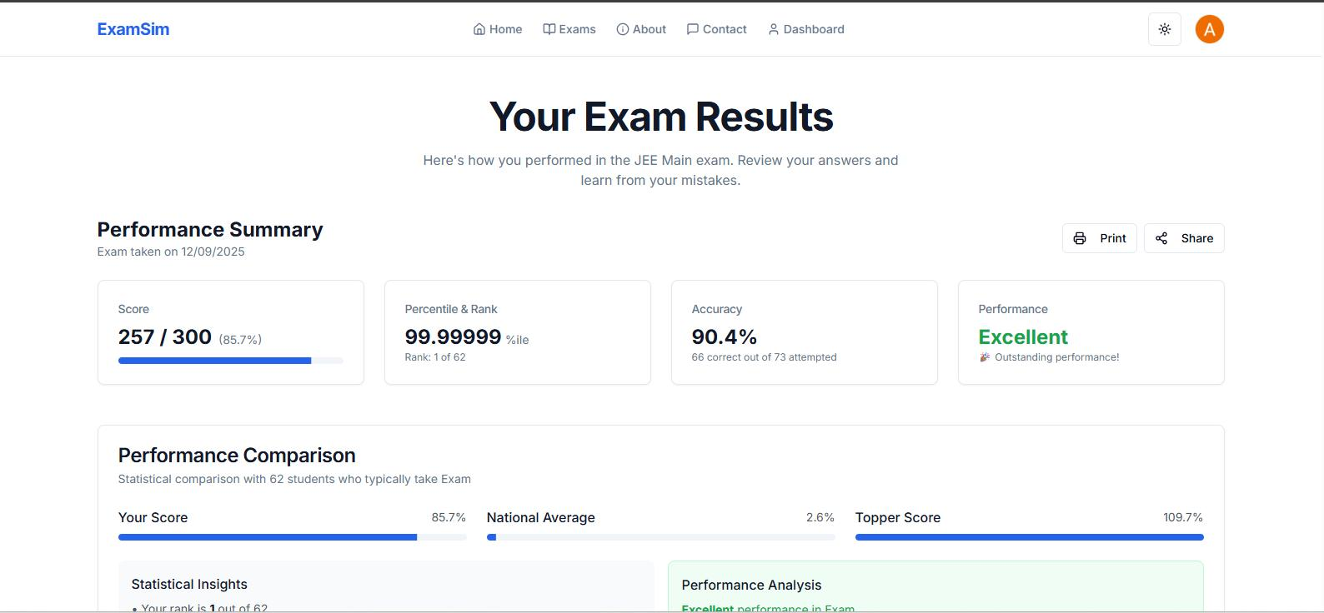
Output 3: Result Page
After clicking Submit Exam, the system automatically checks the answers and calculates marks.

Slide 18
Output 4: Backend terminal
When you execute the server, the terminal displays:
</> Plain text
Online Examination System Started
Open http://localhost:3000
Result :
Thus, the Smart Online Examination System was successfully designed and implemented using HTML, CSS, JavaScript, Node.js, and Express.js. Students can attend online examinations, submit their answers, and receive automatically generated results.

Slide 19


